Slide 1

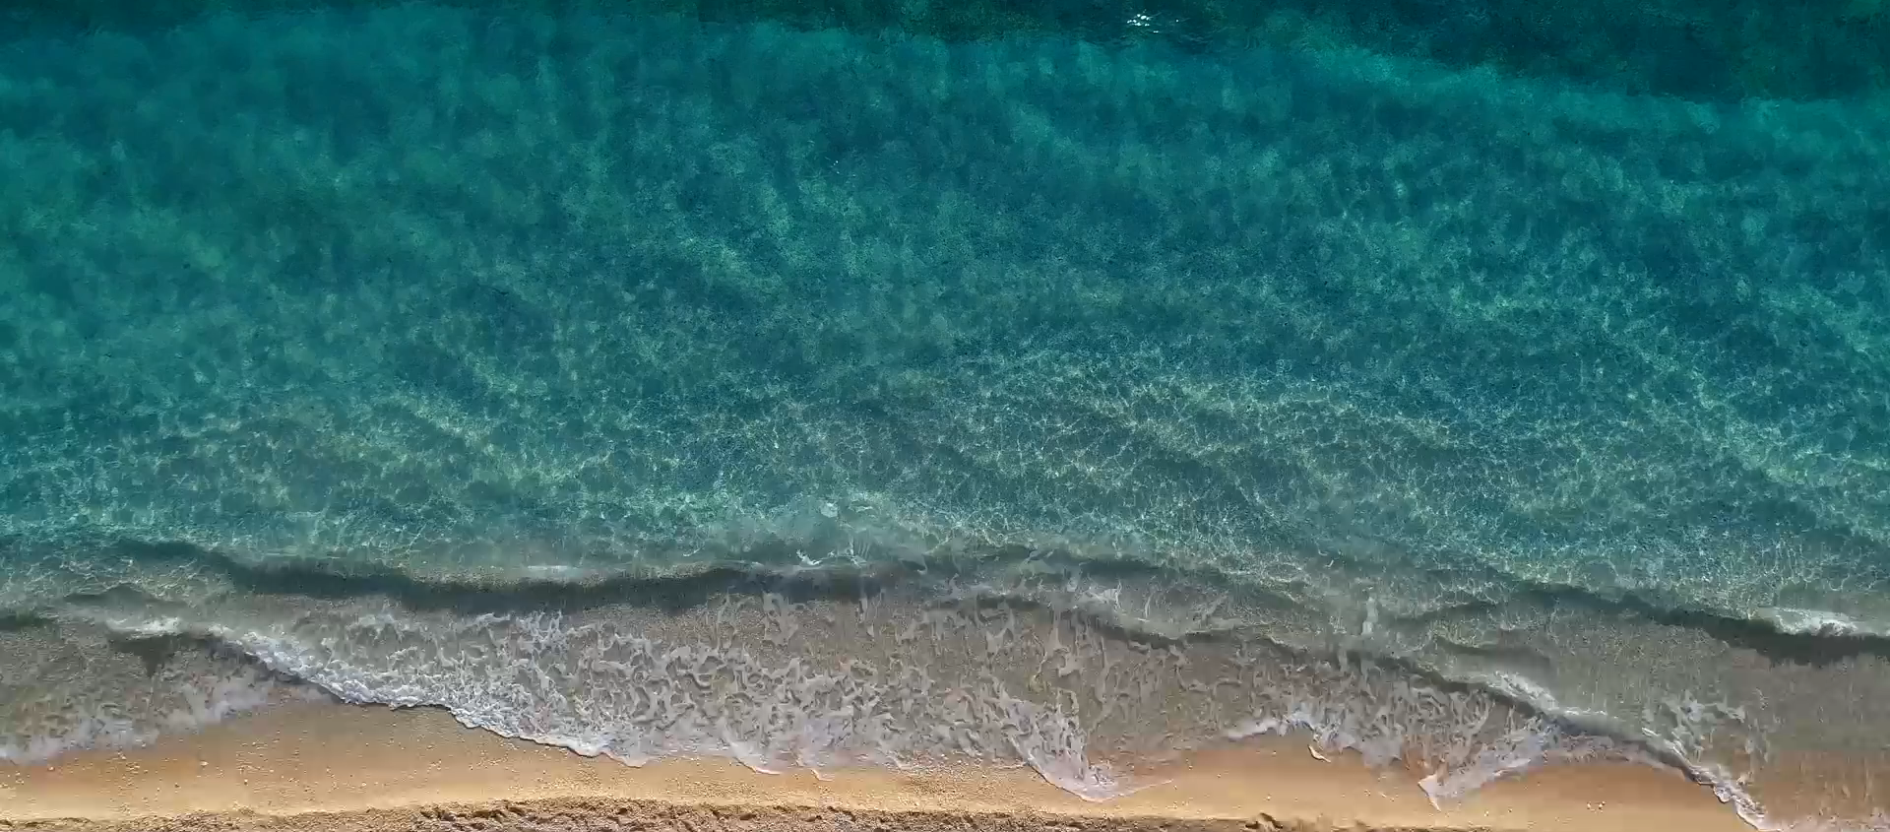

Slide 2



Learning Outcomes
1
2
3
Explain the basics of 360 filming and photography, including its applications and audience considerations.
Be able to set up and operate a 360 camera, including using different shooting modes and basic controls.
Be able to edit 360 footage using the Insta360 studio and share their content on various platforms.

Slide 3
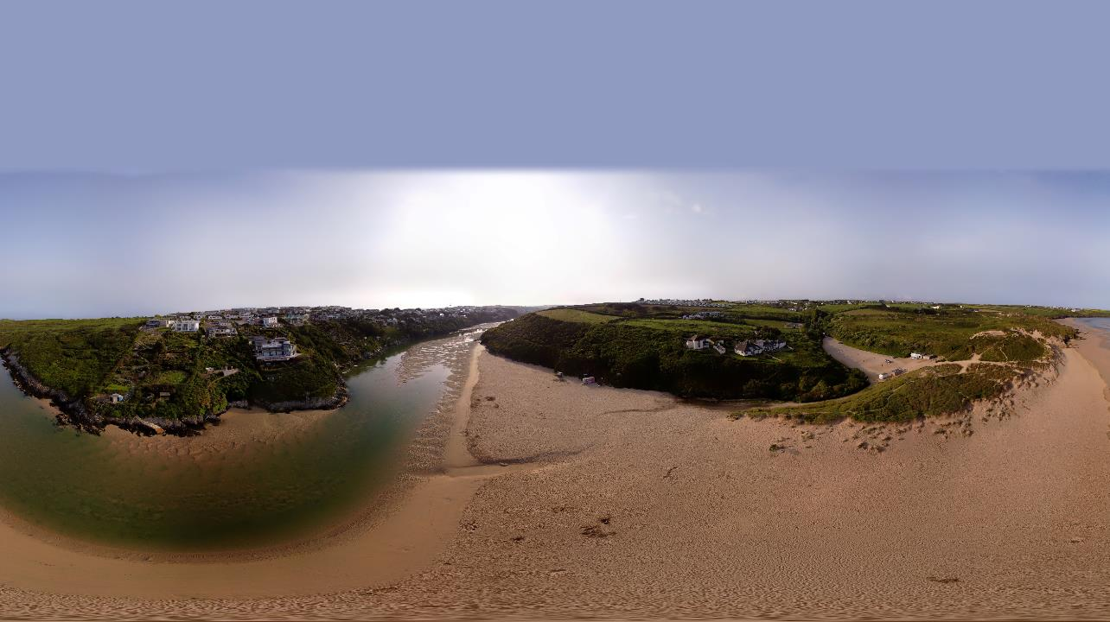
What is 360 Filming / Photography?

Slide 4
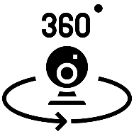


360-degree videos, also known as surround video, or immersive videos, or spherical videos.
Photos or recordings where a view in every direction is recorded at the same time, shot using an omnidirectional camera or a collection of cameras
360 footage is stitched into one spherical video piece. This process is done either by the camera itself, or using specialised software

Slide 5
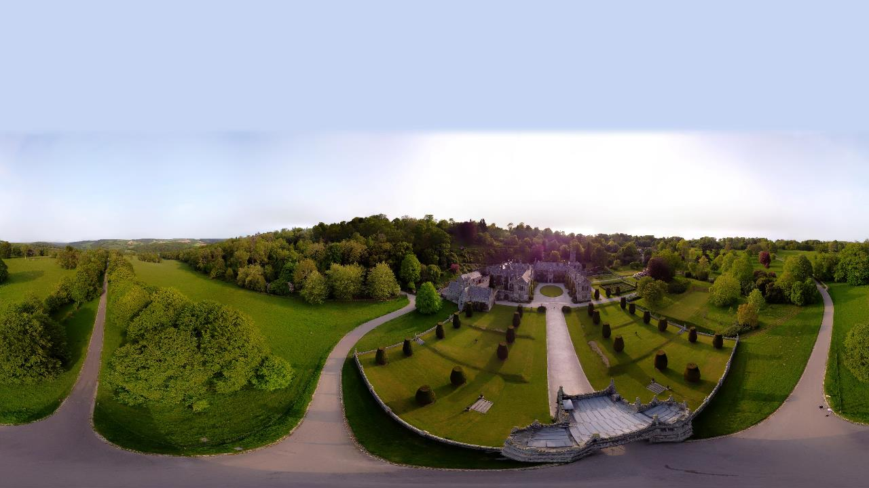
360-degree files are typically formatted in an equirectangular image or video.

Slide 6





AUDIENCE
STORY
POINT OF VIEW
CAMERA LOCATION
HIDING THE CREW
Understanding
360
Who is the audience?
What story do we want to tell?
Which viewpoint do you want to use?
Camera location and movement around the camera
Can you hide from the photo / video?

Slide 7
AUDIENCE
STORY
POINT OF VIEW
CAMERA LOCATION
HIDING THE CREW
Understanding
360
Who is the audience?
What story do we want to tell?
Which viewpoint do you want to use?
Camera location and movement around the camera
Can you hide from the photo / video?

Slide 8
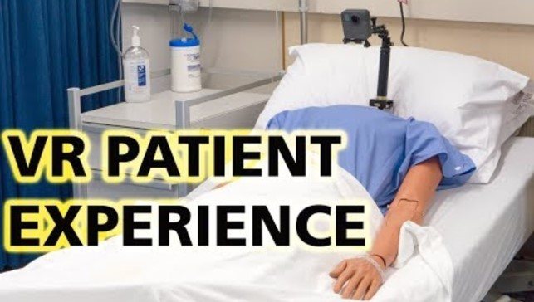


Slide 9
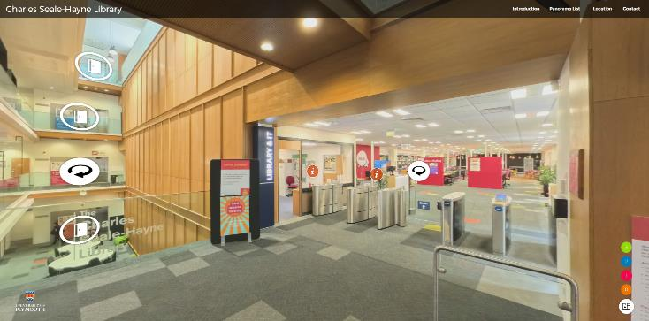
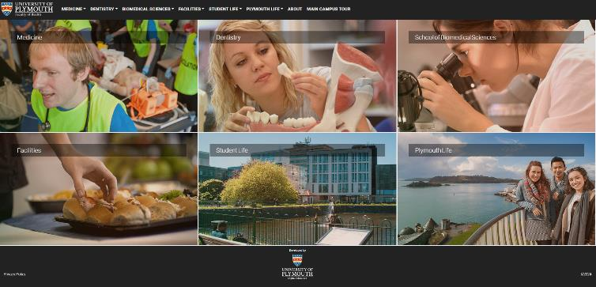

Slide 10
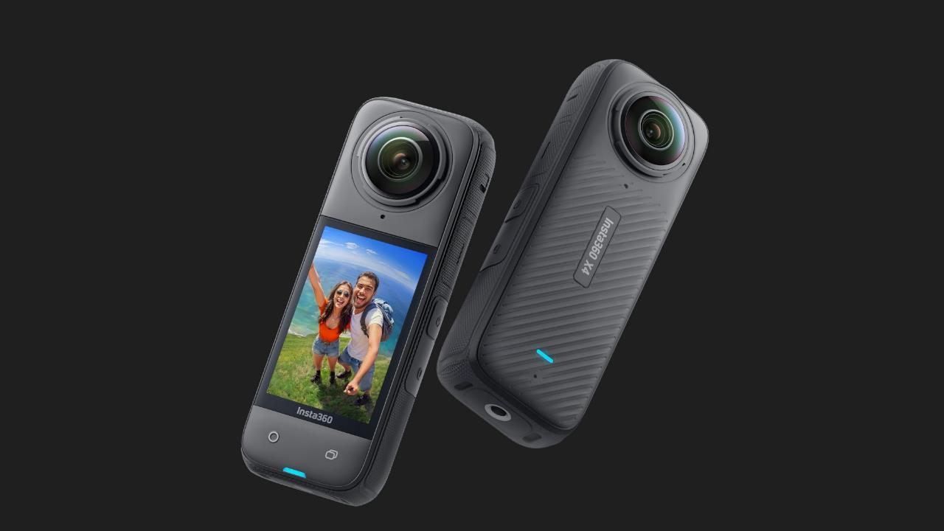
360 Hardware

Slide 11
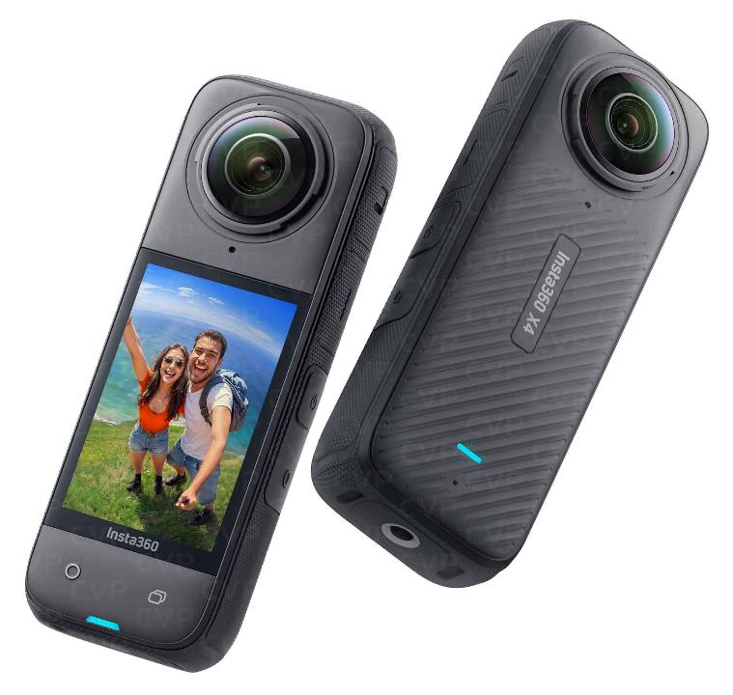
Unboxing
360 Camera
Type-C to C Cable
Memory Card
Protective Lens cover
ALWAYS PLACE THE CAMERA ON A SOFT SURFACE - THE LENSES ARE DELICATE AND WILL SCRATCH.

Slide 12
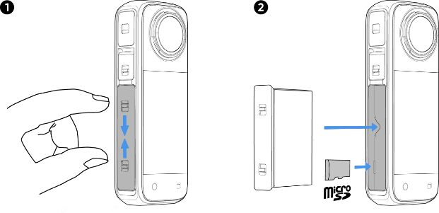
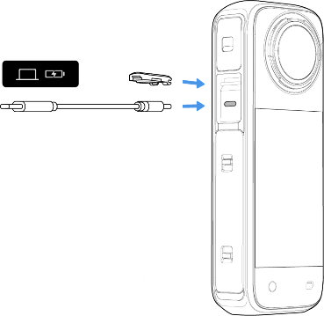
Charging the battery
Changing the battery & Memory Card

Slide 13




POWER
BUTTON
QUICK
BUTTON
SHUTTER
BUTTON
LENS
BUTTON
Basic Camera
Controls
Quickly access preset shooting modes and parameters.
Turn on / off camera
Press and hold for 2s to shutdown
Switch between Single-Lens Mode and 360 Mode
Off – Quick Record
On – Start / Stop recording

Slide 14
POWER
BUTTON
QUICK
BUTTON
SHUTTER
BUTTON
LENS
BUTTON
Basic Camera
Controls
Turn on / off camera
Press and hold for 2s to shutdown
Quickly access preset shooting modes and parameters.
Off – Quick Record
On – Start / Stop recording
Switch between Single-Lens Mode and 360 Mode

Slide 15
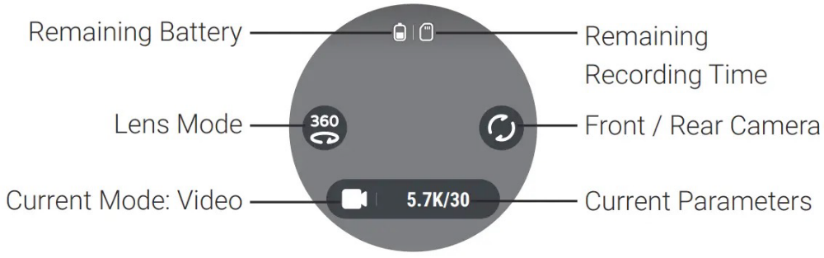

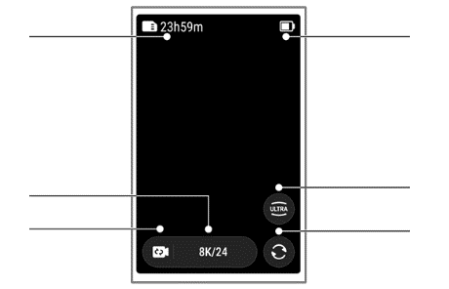
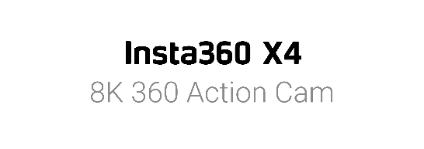
Remaining Record Time
Remaining Battery
Current Parameters
Current Mode: Video
Lens Mode
Front / Rear Camera

Slide 16


Photo Mode: Capture 360-degree photos – 72MP resolution (larger the better)
HDR Photo: For high dynamic range photos. Please keep the camera still while shooting
Video: Record 360-degree videos - resolution (4k)
Recording for long periods of time (20mins+) can result in the camera getting hot and shutting down.

Slide 17
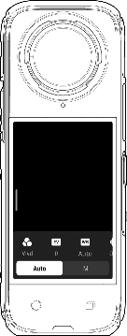
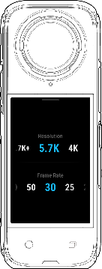
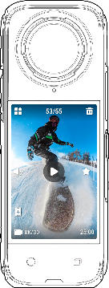
Swipe left to view shooting parameters.
Swipe up to view shooting settings.
Swipe right to enter the Album page.
Video – Resolution & Framerate
Photo – Resolution & Timer
Recommend all settings to be Automatic
Review your recordings
Delete videos / photos

Slide 18
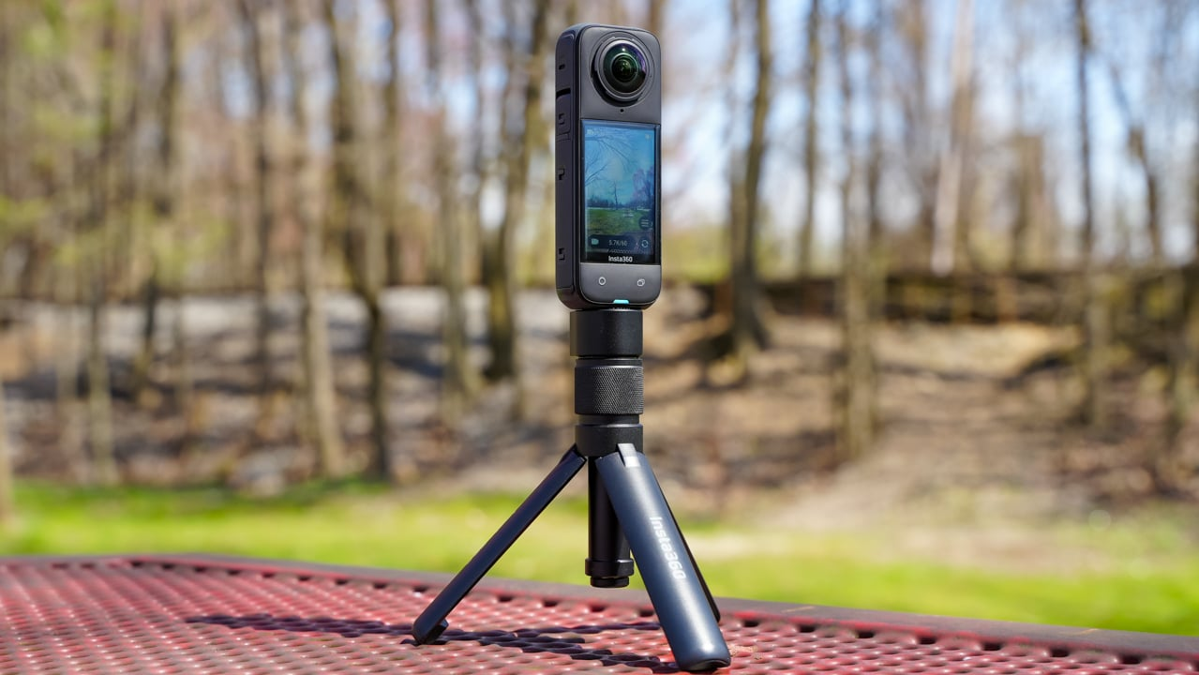
Shooting Tips

Slide 19
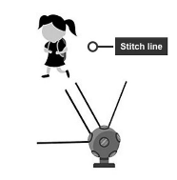


Stitch Line: A 'stitch line' appears where the 'eyes' of your camera rig overlap. It's where two images are stitched together in post.
Try not to have too much action directly in a stitch line. Try to aim the stitch lines at a blank wall.
Stitch lines are approximately 60cm either side of the camera.
Lighting: ISO settings / Automatic - Ensure good lighting for better image quality. Recommend keeping to Automatic settings.
Camera Location: Consider your 360 camera as a silent and immobile passenger who's come along for the trip. Think about how you would talk to a person in real life. Where would you sit or stand?

Slide 20
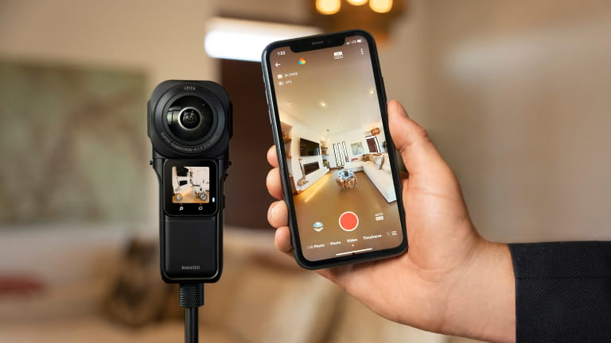
Insta360 App

Slide 21
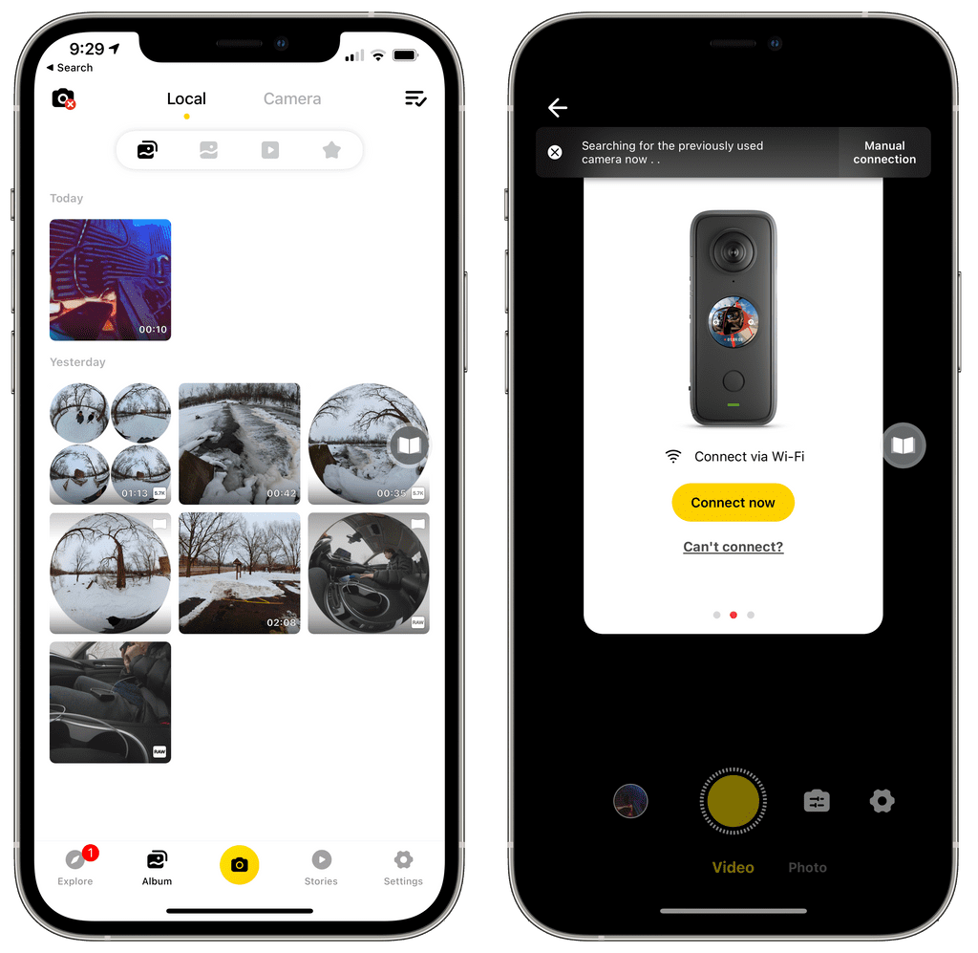
Download the Insta360 app from the Apple App Store or Google Play Store.
Enable Wi-Fi and Bluetooth on your smartphone.
Turn on 360 camera.
Open the Insta360 app and click the camera icon at the bottom of the page.
You will be able to change settings, remotely start / stop recordings and take photos.

Slide 22
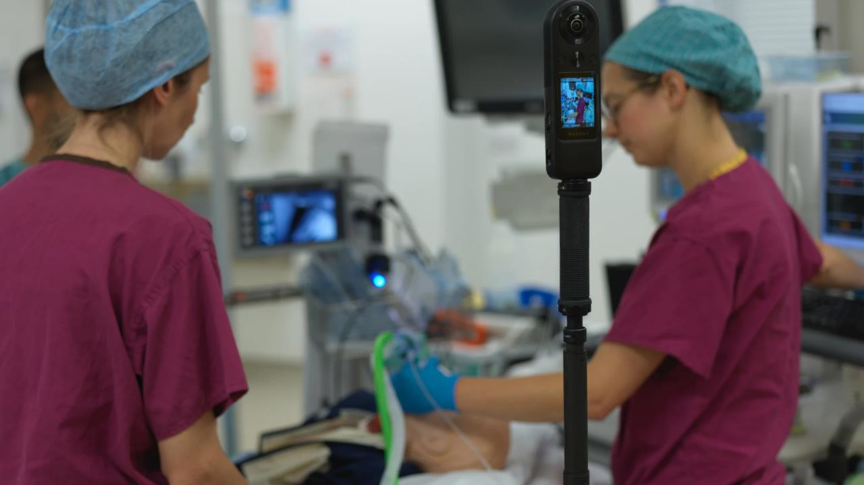
Capturing Test Footage

Slide 23
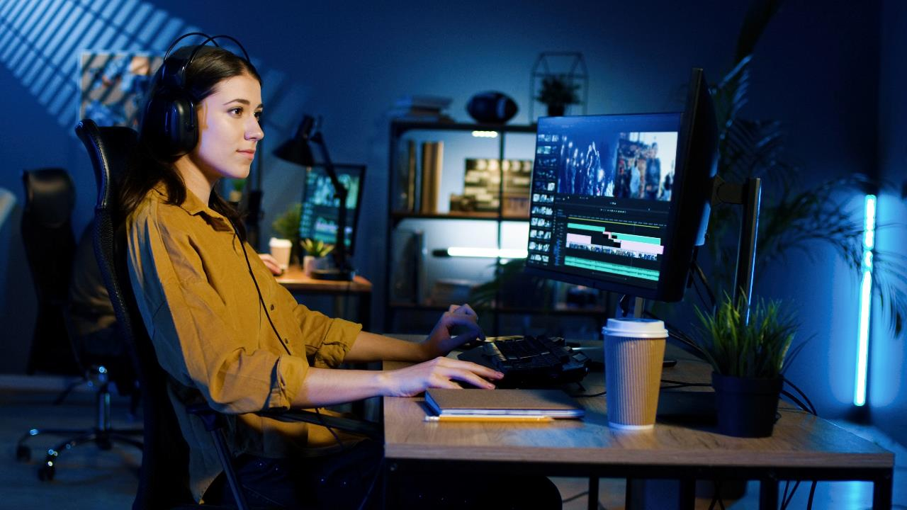
Editing in Insta360 Studio

Slide 24
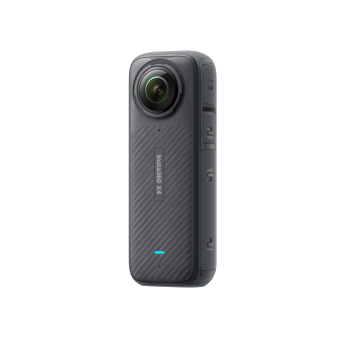

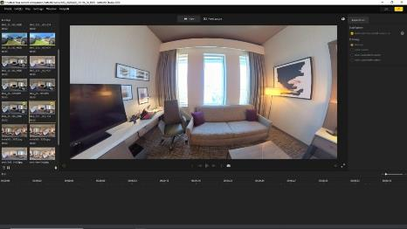

Use the cable to connect 360 to your computer.
Power on the camera and select 'USB Drive Mode'. Wait for the computer to recognise the 360 camera as a drive.
Open DCIM > Camera01 folder and copy photos/videos from this folder to your computer.
If you import a 360 video, please make sure that both files are saved in the same folder and the file name has not been modified (360 video generates two video files LRV & VID).

Slide 25
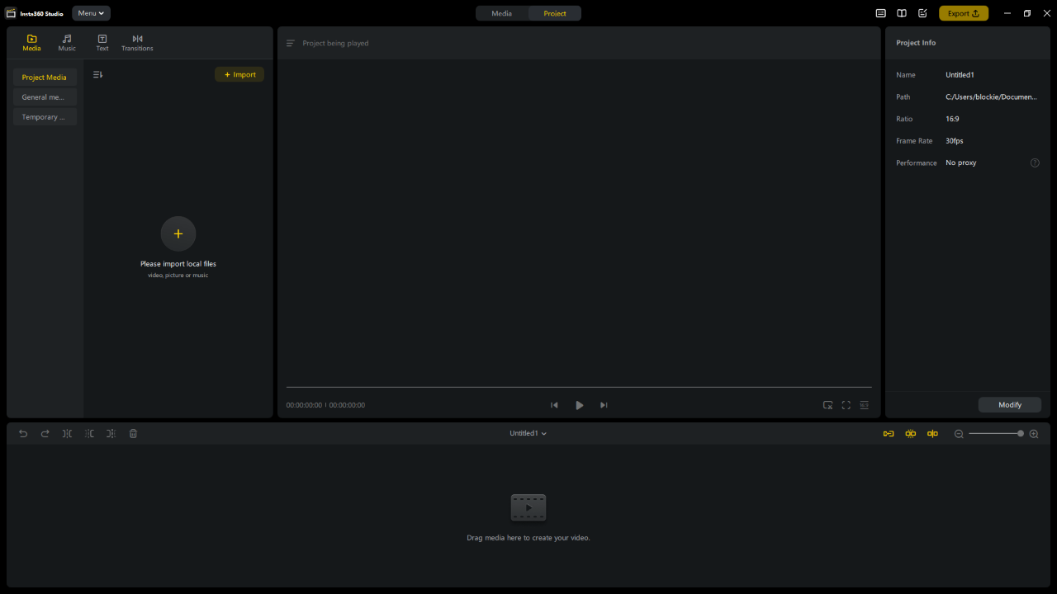
Menu Bar
Footage Panel
Play Window
Project Info
Timeline Panel

Slide 26
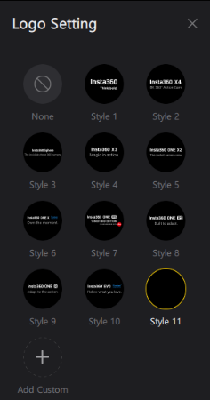

Basic Editing:
Trim – Beginning (Shortcut key Q)
Logo Settings (Nadir):
Here, you can set logo style/size/position to cover up monopod / tripods
Trim – Ending (Shortcut key W)

Slide 27
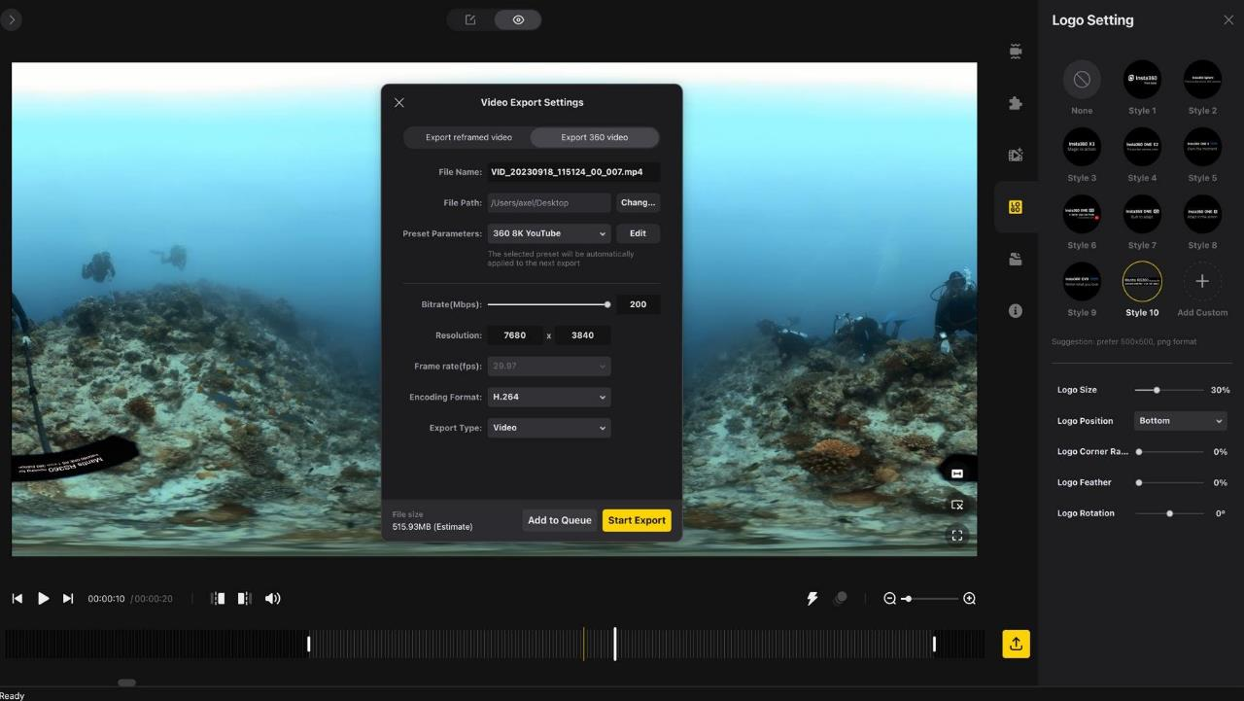
Exporting 360 Footage

Slide 28

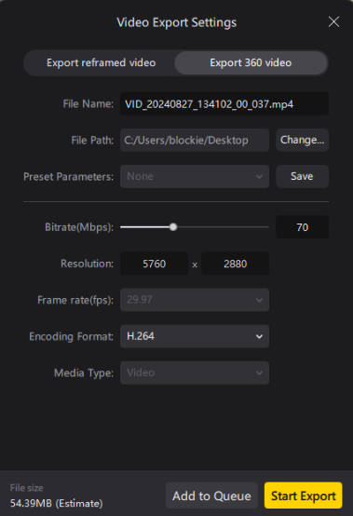


Recommended Bitrate 70 - 100Mbps
Compression occurs within Panopto / YouTube.
However, keep this as high as possible for future applications
Uses a lot of disk space!

Slide 29

Adding 360 Footage to Panopto & DLE

Slide 30
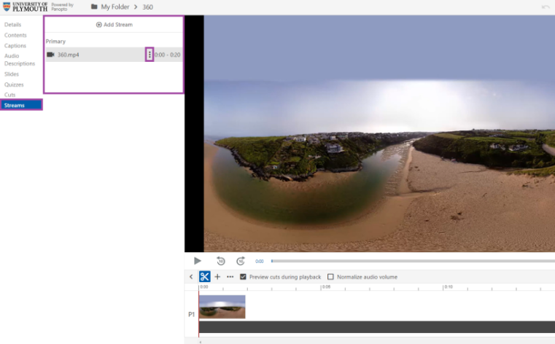
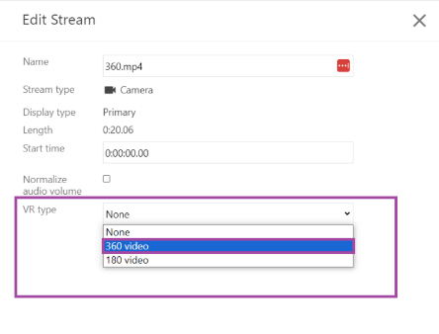

Slide 31
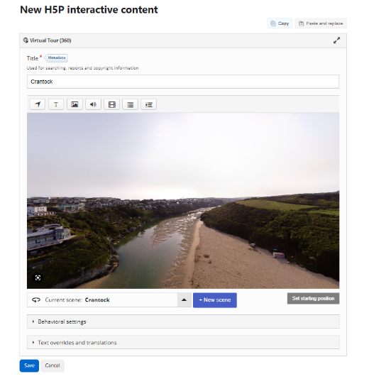

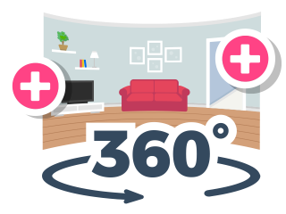

Slide 32
Learning Outcomes Revisited
1
2
3
Explain the basics of 360 filming and photography, including its applications and audience considerations.
Be able to set up and operate a 360 camera, including using different shooting modes and basic controls.
Be able to edit 360 footage using the Insta360 studio and share their content on various platforms.

